Slide 1

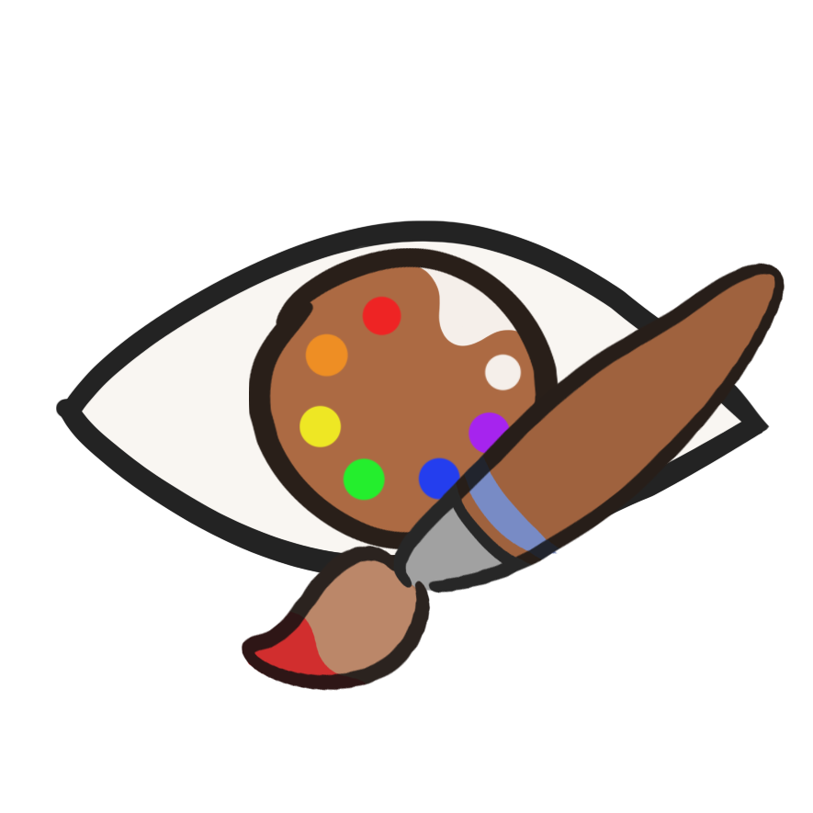
Art is Opinion
Eye tracker painting game

Slide 2
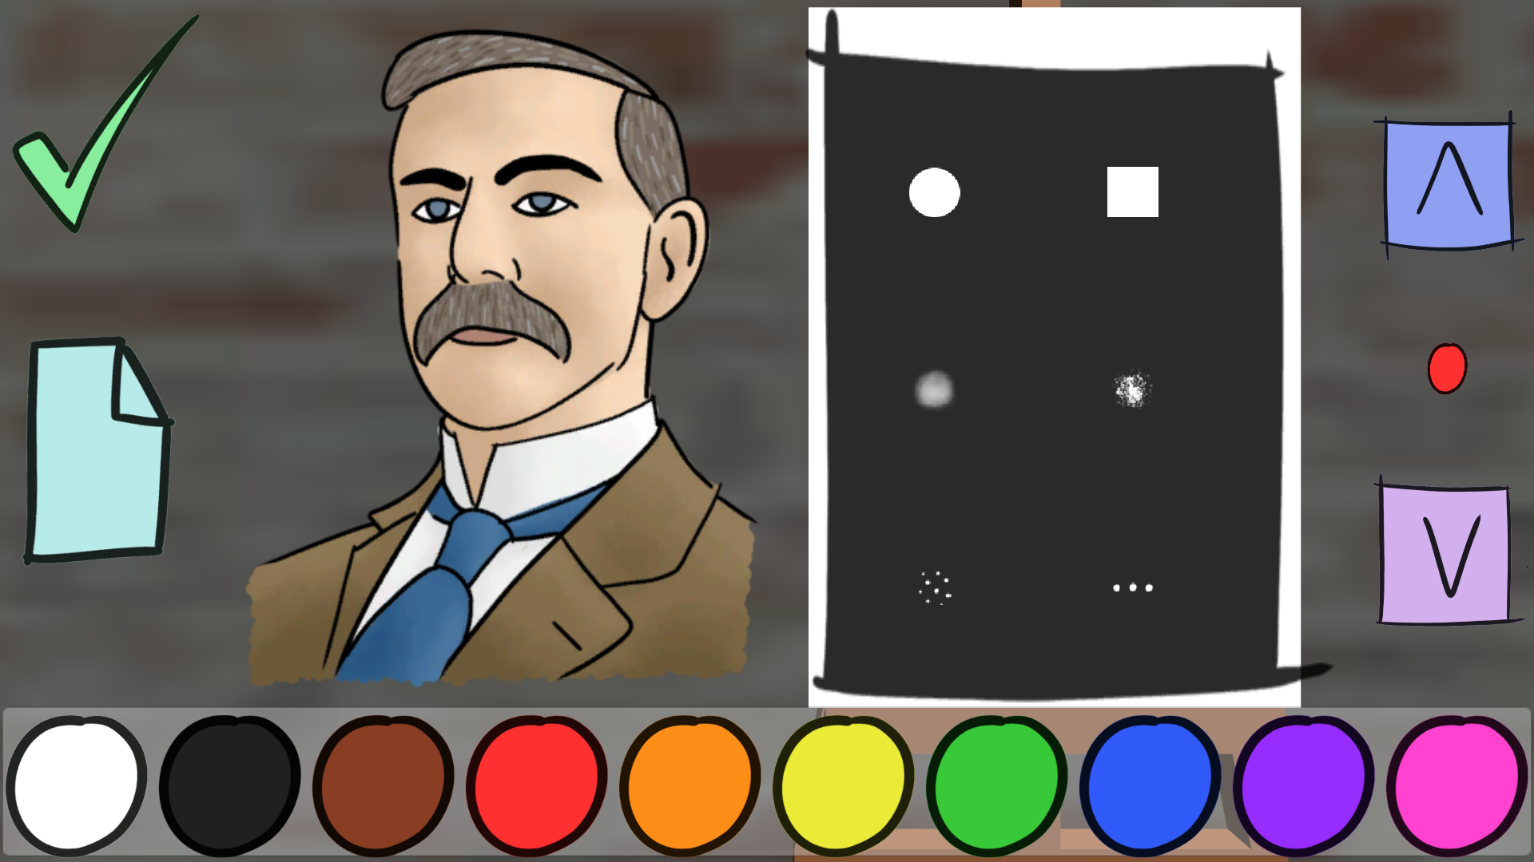
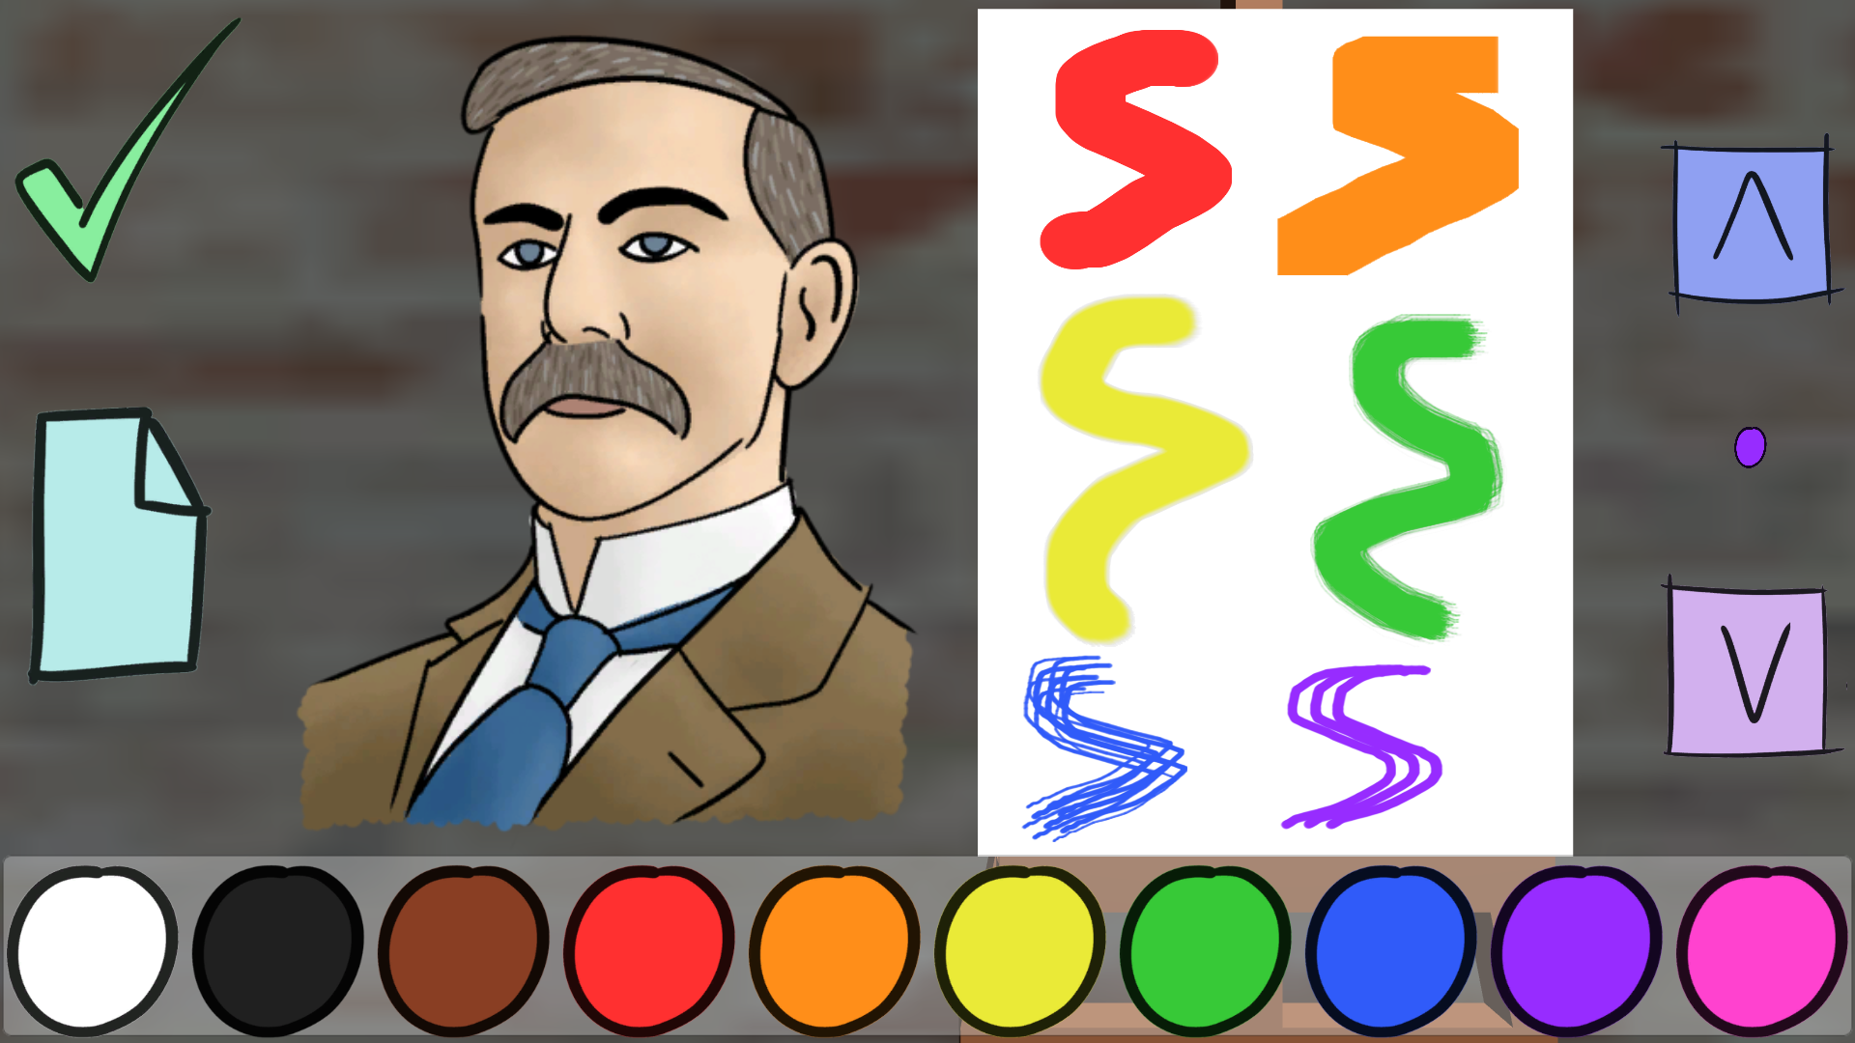
Current Features
Has a free draw mode and a mode where you draw a random character
You can either accept or decline who you can draw
Able to draw by tracing the character on the left with your eyes using the Tobii Eye-tracker
You can look at the character for more stable lines and draw on the canvas
Able to change the size, shape and colour of the main brush with a preview
There is a gallery system to view the last 10 objects that have been saved by the player
Use the UI by looking at a button/canvas and pressing Space

Slide 3
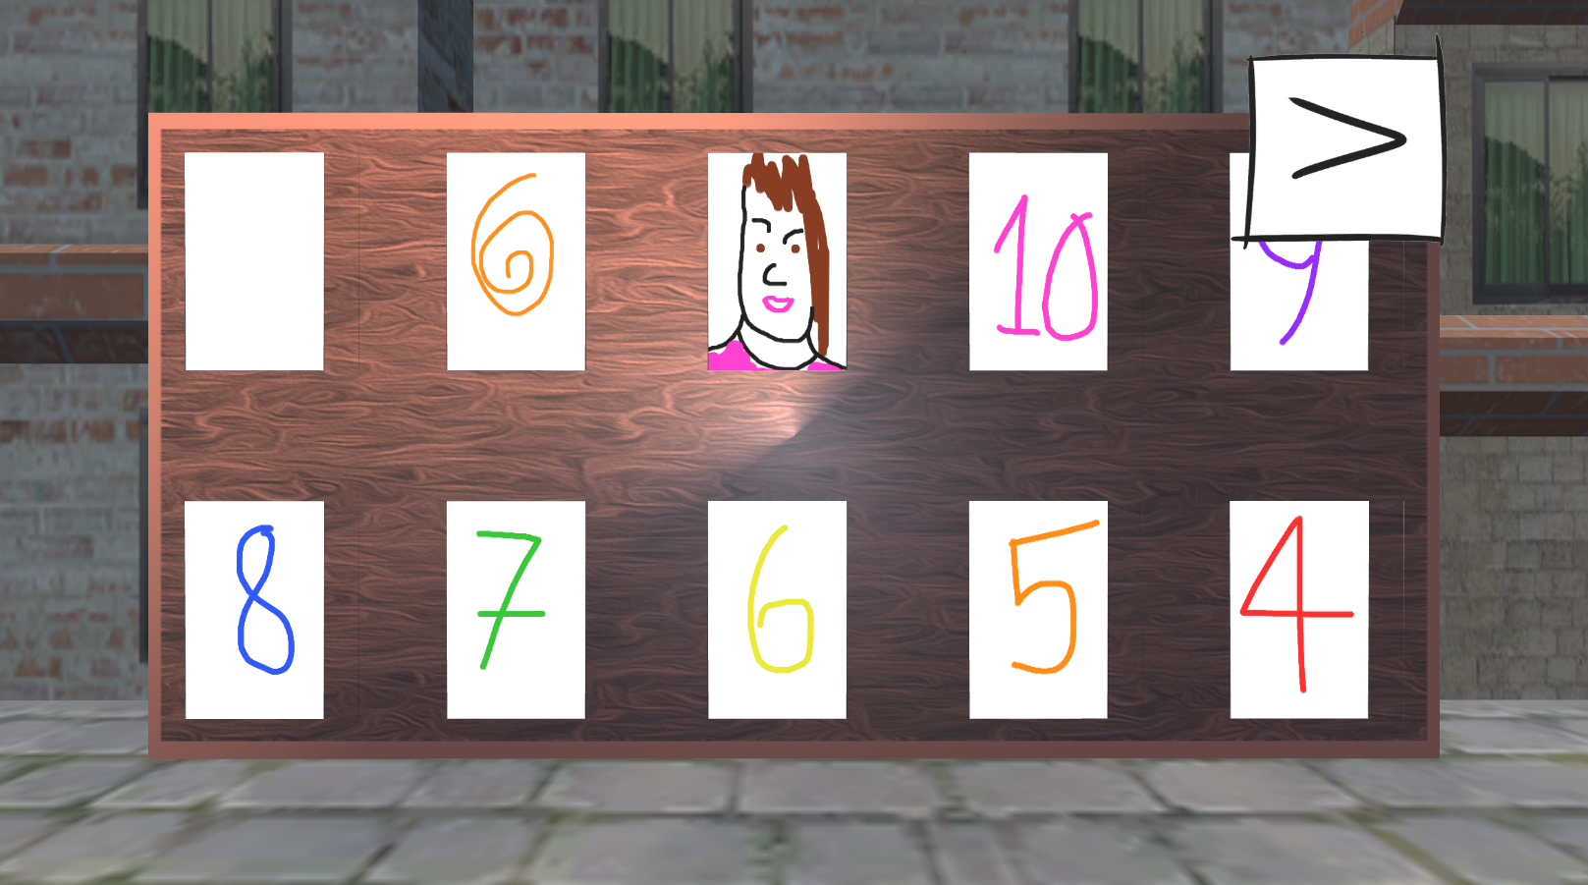
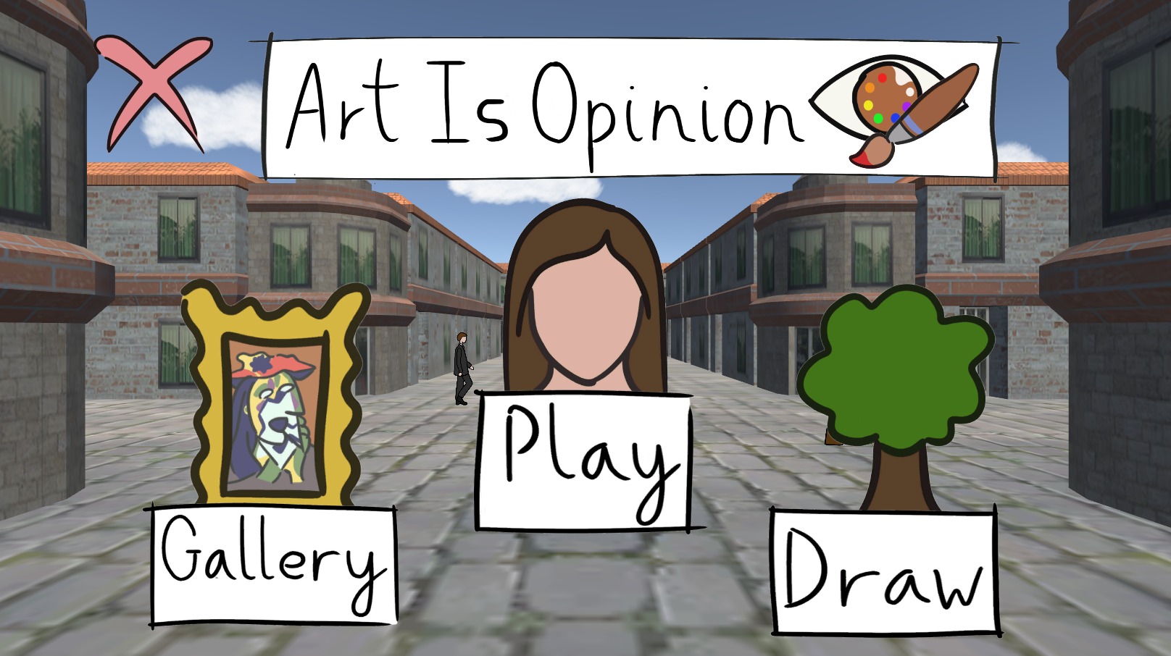
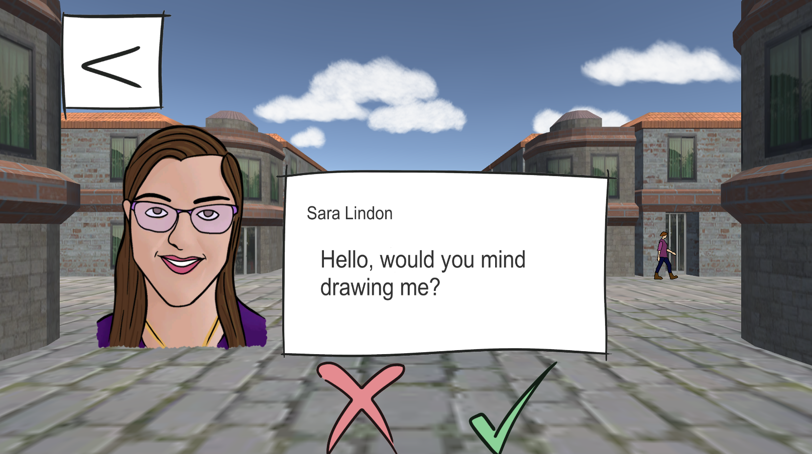
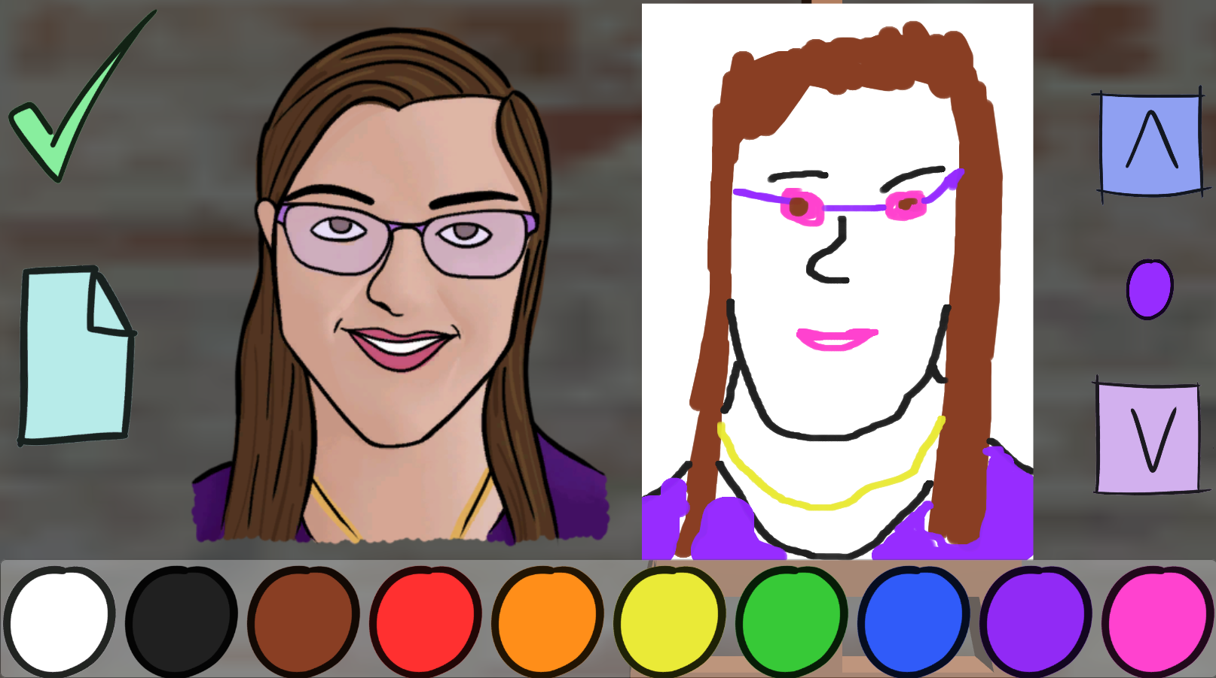
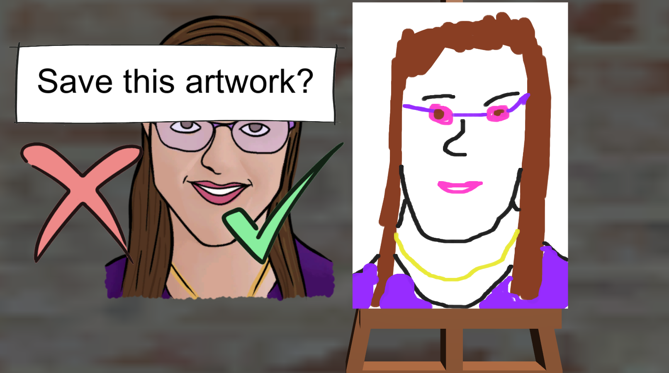
In Game images

Slide 4
What we would have done to improve
Refined the games responses to the Tobii input, making it quicker and smoother, with easy access to Tobii equipment.
Add dialogue that is the character commenting on the player's painting. While it was a fun concept, it was decided it would be too distracting or break the flow of gameplay. However, this addition would have added more personality to the game if done correctly.
Devised our own custom brush set up to better suit the game.
Make changes to the Load Image Script to be able to load images into the gallery when there are less than 10 images saved

